Slide 1
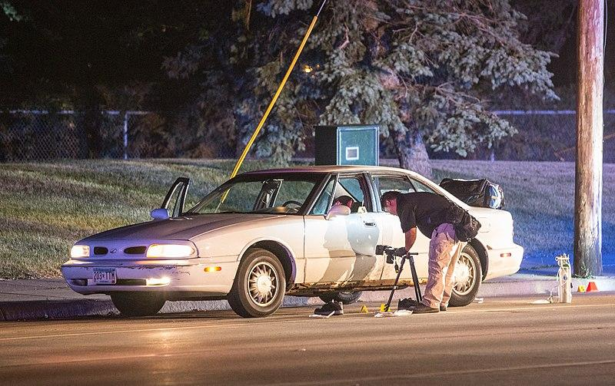
Fatal Police Shootings in United States
By: Alex, Daniel, Laura, Michelle
Notes:
https://www.flickr.com/photos/diversey/27864126610/

Slide 2

Motivations
Initially wanted to investigate police officer compensation compared to incidences of crime
Original cities: San Francisco, New York, and Chicago
Ultimately difficult to find crime data and/or payroll compensation with consistent data values.
2014 killing of Michael Brown in Ferguson, Missouri
Look up various statistics that played a part in the decision to use lethal force
Notes:
Dan
At first, we wanted to investigate police officer compensation compared to incidences of crime rates. Originally, we wanted to examine San Francisco, New York, and Chicago.
However, it was difficult to find crime data and/or payroll compensation with consistent data values.
The 2014 killing of Michael Brown in Ferguson, Missouri, began the protest movement culminating in Black Lives Matter and an increased focus on police accountability nationwide. We used our inspiration from the first question to investigate the trends around fatal shootings by the police
We wanted to investigate
whether body cameras increased police accountability
The age distribution of victims
Average age of victims by race
Total fatalities by race
Most commonly used weapons that resulted in deadly force
The population of those who show signs of mental health
What attributes are police inclined to shoot non-fleeing civilians

Slide 3

Background Info and Dataset
The Washington Post is compiling a database of every fatal shooting in the United States by a police officer in the line of duty since Jan. 1, 2015.
In 2015, The Post began tracking more than a dozen details about each killing — including the race of the deceased, the circumstances of the shooting, whether the person was armed and whether the victim was experiencing a mental-health crisis — by culling local news reports, law enforcement websites and social media and by monitoring independent databases.
The general criteria for the attack label was that there was the most direct and immediate threat to life.
That would include incidents where officers or others were shot at, threatened with a gun, attacked with other weapons or physical force, etc.
The attack category is meant to flag the highest level of threat.
The threat column and the fleeing column are not necessarily related. For example, there is an incident in which the suspect is moving away from officers (fleeing) and at the same time turns to fire at gun at the officer. Also, attacks represent a status immediately before fatal shots by police; while fleeing could begin slightly earlier and involve a chase.
Notes:
Alex

Slide 4
Data Exploration and Cleanup
We looked all the columns and decided to only look at the following:
Date of Incident
Weapon Used
Age
Mental Illness
Gender
Flee
Body Camera
State
We renamed the columns to the following:
Year
Armed
Age
Mental Illness
Gender
Flee
Body Camera
State
3. We did a .count() to account for NaN values. Note that Race had the most NaN values. Date, State, Mental Illness, and Body Camera seem to the mandatory values when taken from police logs.
Date of Incident 3934
Weapon Used 3689
Age 3801
Gender 3931
Race 3656
City 3934
State 3934
Mental Illness 3934
Flee 3800
Body Camera 3934
4. After cleaning, we ended up with 3272 rows. Since the Post updates the raw data, we decided to filter our range from 01/012015 to 12/31/2018.
Notes:
Laura
Date of Incident was changed to Year, Weapon Used to Armed with
Race had the most NaN , after cleaning we were left with 3272, and we went with the last 4 complete years, to narrow scope

Slide 5

Hypothesis
Hypothesis: Police officers are less inclined to use lethal force if civilians are more likely / willing to comply; police accountability, protocol (body cameras), and civilian demographic play an additional role in police officers’ decisions.
Null Hypothesis: Police are indifferent to situations even if the suspect is unarmed, not fleeing, and non-threatening and remain impartial to suspected civilians.
Notes:
Michelle

Slide 6
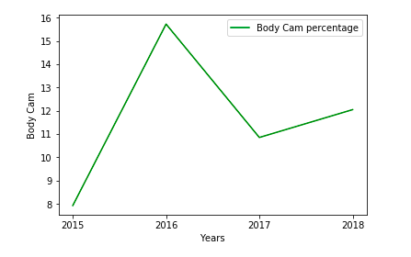
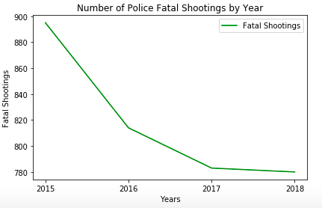
Introduction of Body Cameras in 2015
Notes:
Laura

Slide 7
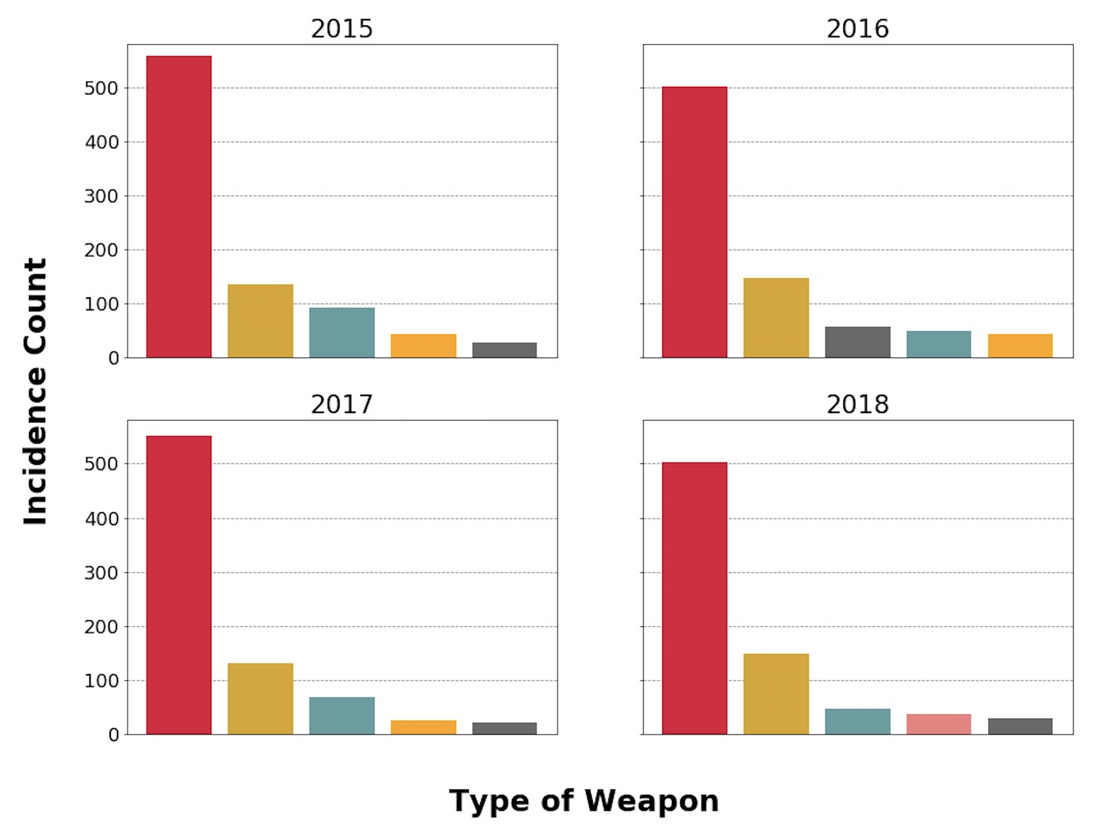
Weapons in Civilian Possession in Fatal Police Shootings
Legend:
Gun
Knife
Unarmed
Toy Weapon
Undetermined
Vehicle
Notes:
Dan
Things to Note:
Two most commonly used weapons used by civilians are a firearm and knife
“Toy Weapon” (e.g. nerf gun, airsoft, paintball) → stronger argument for lethal force being used in the case of self-defense

Slide 8
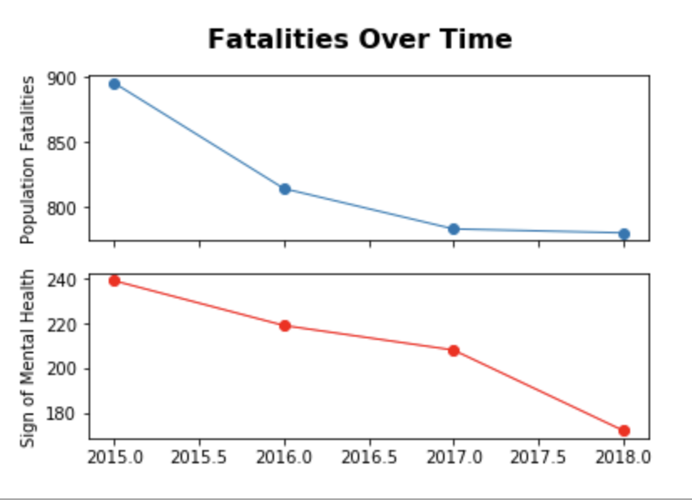
Sample T-Test: Signs of Mental Illness Population
Hypothesis: Population of civilians showing signs of mental health is different from the population of all fatalities sample
Null: Both populations are the same population, and are not random
T-test = -43.308055
pvalue=2.70976584e-05
Since the pvalue < 0.05, this indicates that we can disprove the null hypothesis and so the population of civilians showing signs of mental health is different from the population of all fatalities
Notes:
Michelle

Slide 9
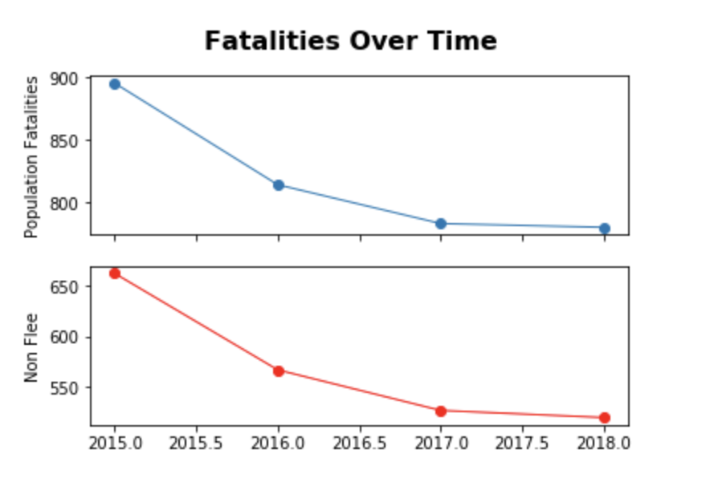
Sample T-Test: Non-Fleeing vs. All Fatalities
Hypothesis: Non-fleeing population is different from the population of all fatalities sample
Null: Both populations are the same population, and are not random
P value = 0.00469387, p< 0.05
There is a significant difference between the non-fleeing civilians who were fatally shot and the population.
Notes:
Michelle

Slide 10
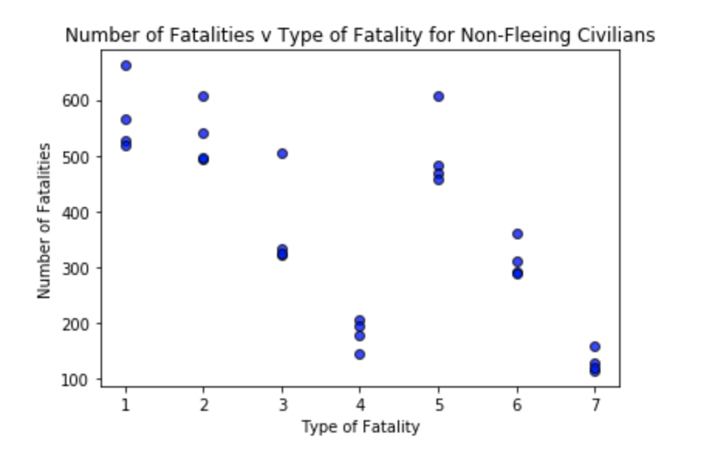
Non-Fleeing Population Scatter Plot
Type of Non-Fleeing Fatalities
1 = Total non-fleeing fatalities
2 = Armed
3 = Attacked
4 = Mental Illness
5 = No Body Cam
6 = Race (W)
7 = Race (B)
Notes:
Michelle

Slide 11
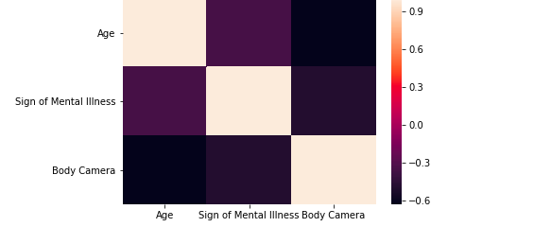
Correlation Across Attributes
No correlation
Notes:
Laura

Slide 12
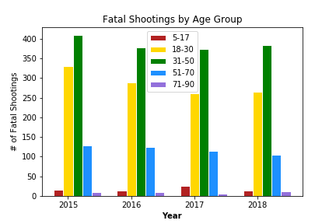
Age Group of Fatal Police Shootings
From 2015 to 2016, there was a steady drop of fatal shootings in 18-30 age group but evened out in 2017 to 2018.
From 2015 to 2018, the 31-50 age group were involved in most fatal shootings.
All other age groups had a steady trend.
This aligns with the overall average age of victims: 36.1
Notes:
Alex

Slide 13
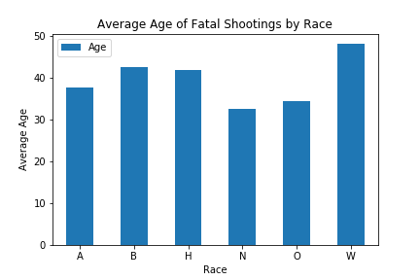
Average Age of Fatal Police Shootings By Race
Legend:
A- Asian
B- Black
H- Hispanic
N- Native American
O- Other
W-White
White were the oldest at 46.
Native Americans were the youngest at 32.
In the US, the average life expectancy is 75.1 years.
These numbers are staggering since it shows the amount of potential years lost. Although some of these incidents warranted deadly force, it’s still a statistic worth showing.
Notes:
Alex

Slide 14
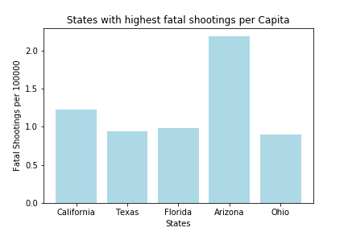
Highest Number of Fatal Shootings per Capita
California Fatal Shootings per Capita : 1.23
Texas Fatal Shootings per Capita : 0.94
Florida Fatal Shooting per Capita: 0.98
Arizona Fatal Shooting per Capita: 2.19
Ohio Fatal Shooting per Capita: 0.90
CA, TX, and FL were expected since they are highly populated. However, it was interesting to see that Arizona was almost double than California.
Interestingly Arizona has the most lax gun laws (no permit, open-carry, no registration, etc), this calls further research into how many unregistered weapons are involved in fatal police shootings.
Notes:
Alex

Slide 15

Conclusion
Hypothesis:
Police were less likely to use lethal force if…
Civilians who were more likely / willing to comply (no weapons, non-fleeing)
Officers were under surveillance technology (body cameras)
Null Hypothesis:
Police remained indifferent to a civilian’s race or age
Location did not play a role
Implications:
As shown from the scatter plot, the presence of body cameras still had a lingering effect on the number of fatal police shootings even after declining between 2016 and 2017
Notes:
Dan

Slide 16
Post Mortem
Our Difficulties:
Changing our scope and data sets
Finding significance in our dataset (i.e, boxplots, line regression)
Figuring out which figures would give us the narrative we wanted to present
We had a lot of Categorical data that we could not use to turn into values for correlation matrix
Other Questions to Explore:
Looking at season/month-by-month - if a time of year saw more/less fatal shootings
Enriching our datasets with another dataset like crime rates to be more meaningful
Further research that could correlate our data to state laws on guns
Notes:
Michelle

Slide 17
Questions?

